Slide 1
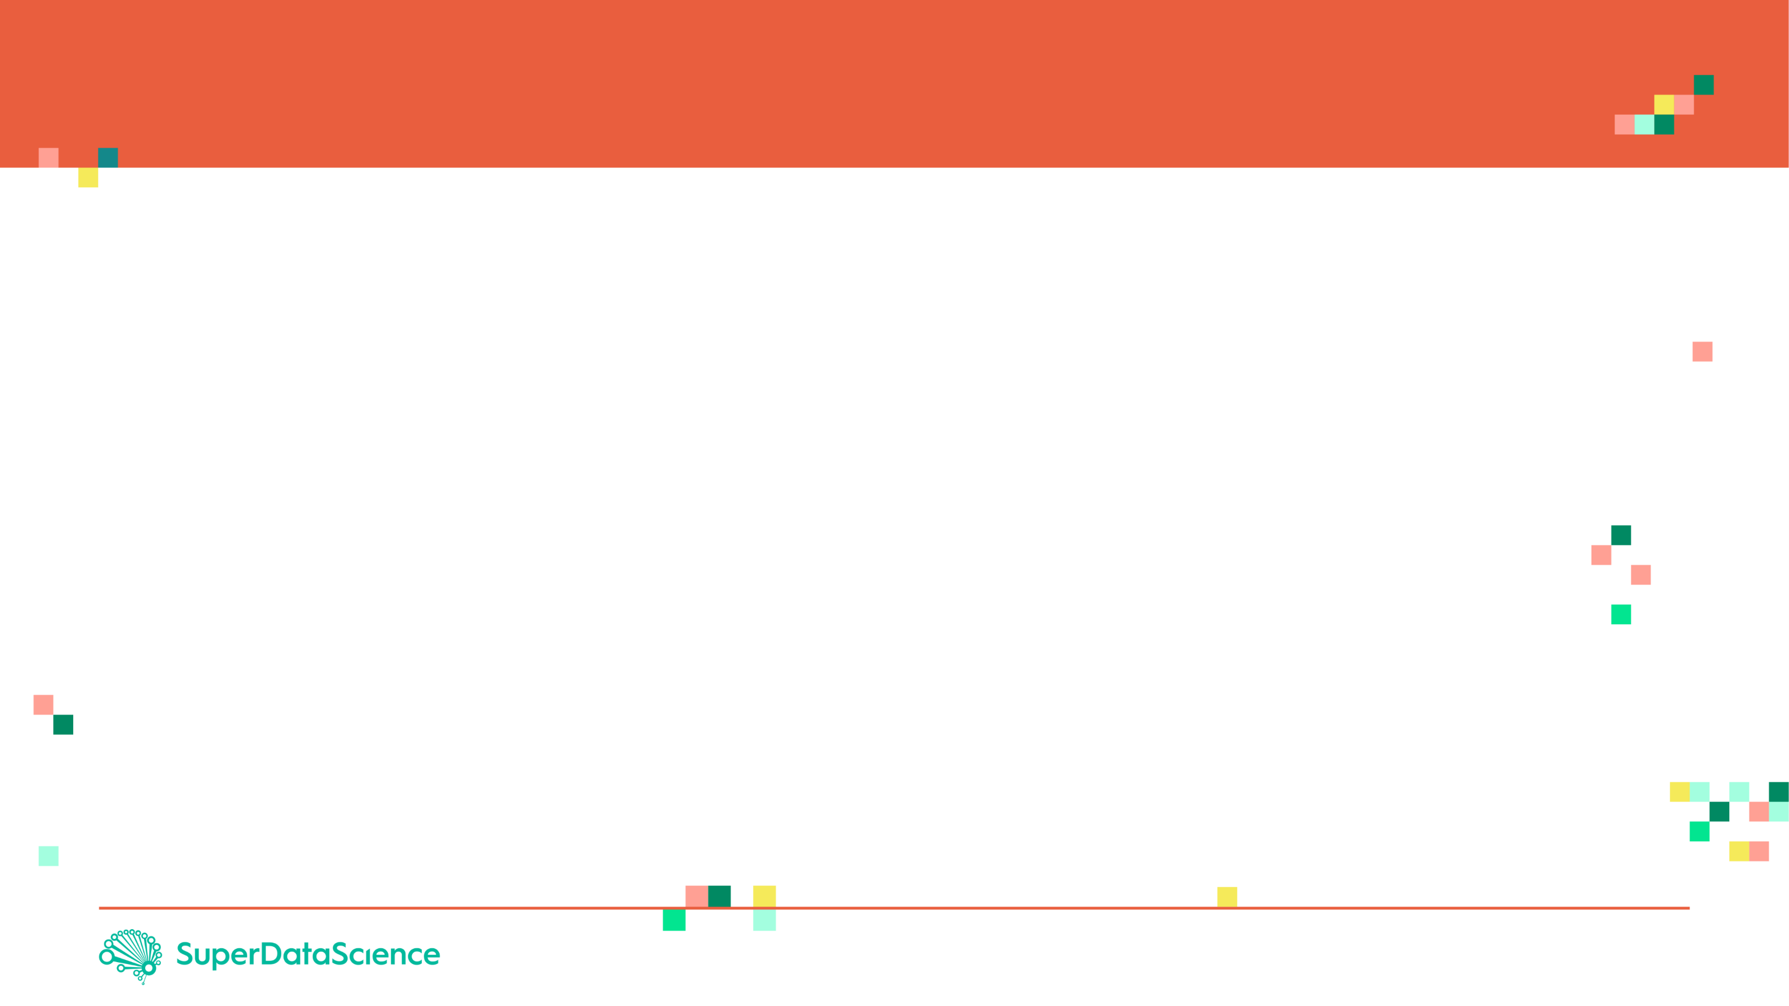
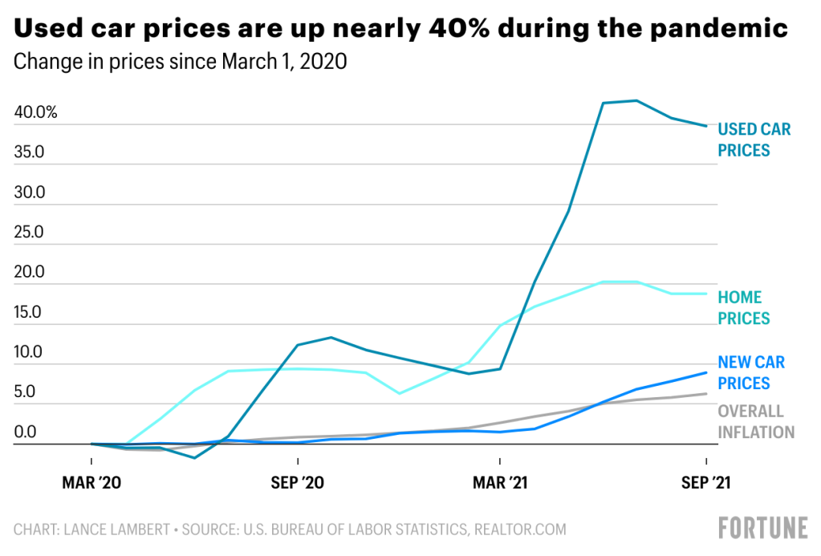
A RESEARCH PROJECT THAT PREDICTS CAR PURCHASE AMOUNT USING ANNS
PRESENTED BY
BONIFACE KARANJA MACHARIA
SMPQ/00849/2018
The need for cars increased exponentially from march 2020. this attracted a rise in demand for business and personal cars.

Slide 2

ARTIFICIAL NEURAL
NETWORKS
CAR PURCHASE
AMOUNT
PREDICTION

Slide 3
PROBLEM STATEMENT & REGRESSION BASICS

Slide 4
PROBLEM STATEMENT
You are working as a car salesman and you would like to develop a model to predict the total dollar amount that customers are willing to pay given the following attributes:
Customer Name
Customer e-mail
Country
Gender
Age
Annual Salary
Credit Card Debt
Net Worth
The model should predict:
Car Purchase Amount
REGRESSION TASK!

Slide 5
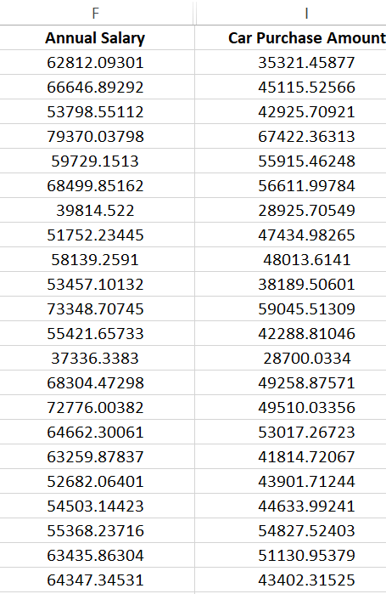
WHAT IS REGRESSION? INTUITION
Regression works by predicting value of one variable Y based on another variable X.
X is called the independent variable and Y is called the dependant variable.
CAR PURCHASE AMOUNT
ANNUAL SALARY

Slide 6

REGRESSION MATH!
Goal is to obtain a relationship (model) between the Annual salary and car purchasing amount.
MODEL! (GOAL)
$$y=b+m∗x$$
$2K
CAR PURCHASING AMOUNT
DEPENDANT VARIABLE
CAR PURCHASING AMOUNT ($)
INDEPENDENT VARIABLE
ANNUAL SALARY ($)
+10K
ANNUAL SALARY

Slide 7
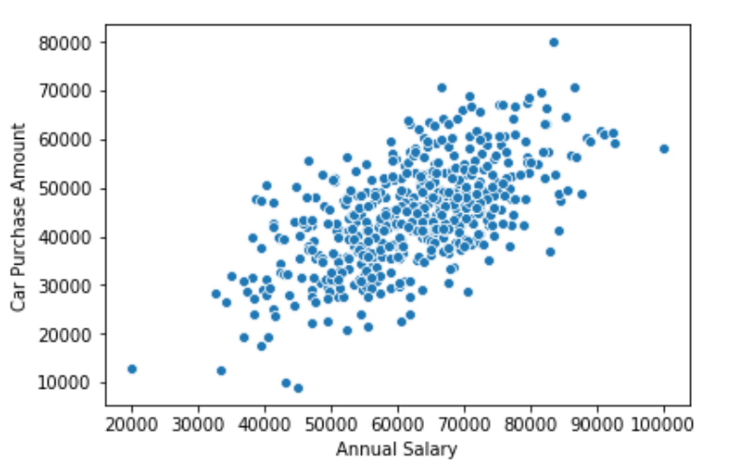






HOW ARE WE GOING TO USE THE MODEL?
Once the coefficients ‘m’ and ‘b’ are obtained, you have obtained a regression model!
This “trained” model can be later used to predict car purchase amount (dollars) based on the annual salary.
$$Y$$
$$\text{y}\text{ = }\text{mX}\text{+}\text{b}$$
DEPENDANT
VARIABLE
INDEPENDANT
VARIABLE
$$m$$
$$b$$
$$\text{X}$$
$$X$$

Slide 8
WHAT ARE ANNs AND HOW DO THEY LEARN?

Slide 9
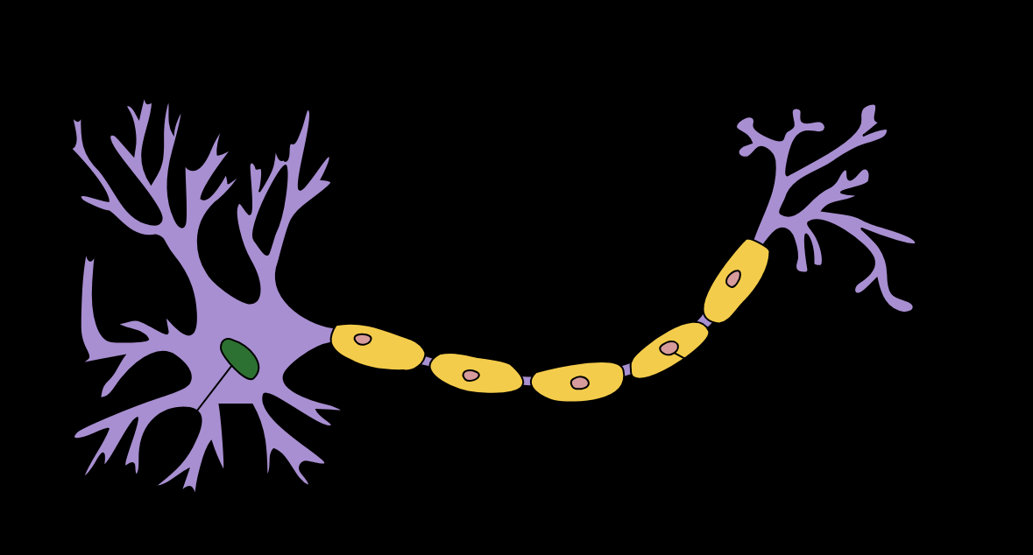
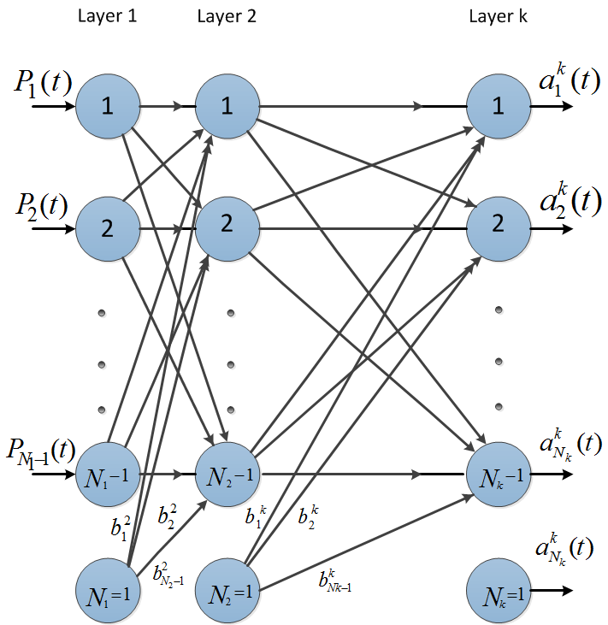
ARTIFICIAL NEURAL NETWORK: INTRODUCTION
The brain has over 100 billion neurons communicating through electrical and chemical signals.
Neurons communicate with each other and help us see, think, and generate ideas.
Human brain learns by creating connections among these neurons.
ANNs are information processing models inspired by the human brain.
Photo Credit: https://commons.wikimedia.org/wiki/File:Neuron_Hand-tuned.svg

Slide 10
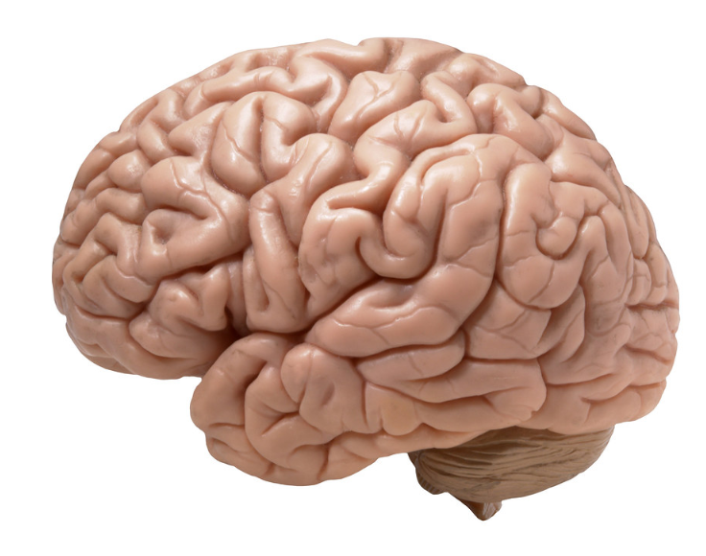

HOW DO HUMANS LEARN? FROM EXPERIENCE
Humans learn from experience (by example)
~Desired Outputs
LABEL: CAT!
Inputs
Deviated Outputs
Desired (Correct) Output
Update
Error
Photo Credit: https://www.flickr.com/photos/flamephoenix1991/8376271918
Photo Credit: https://www.pexels.com/photo/grey-and-white-short-fur-cat-104827/

Slide 11
SINGLE NEURON MODEL

Slide 12
NEURON MATHEMATICAL MODEL
The neuron collects signals from input channels named dendrites, processes information in its nucleus, and then generates an output in a long thin branch called axon.
X1
W1
NEURON
X2
W2
W3
DENDRITES
X3
AXON
NUCLEAS

Slide 13








NEURON MATHEMATICAL MODEL
Bias allows to shift the activation function curve up or down.
Number of adjustable parameters = 4 (3 weights and 1 bias).
Activation function “F”.
b
$$X_{1}$$
$$W_{1}$$
F
$$W_{2}$$
INPUTS/INDEPENDENT VARIABLES
$$X_{2}$$
$$W_{3}$$
$$X_{3}$$
$$y=f(X_{1}W_{1}+X_{2}W_{2}+X_{3}W_{3}+b)$$

Slide 14
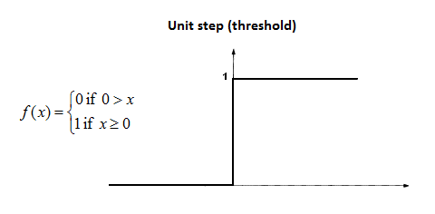










SINGLE NEURON MODEL IN ACTION
Let’s assume that the activation function is a Unit Step Activation Function.
The activation functions is used to map the input between (0, 1).
$$b=0$$
Input #1=1
$$X_{1}$$
$W_{1}$=0.7
F
$$X_{2}$$
$$W_{2}=0.1$$
Input #2=3
$$W_{3}=0.2$$
$$y=f\left(X_{1}W_{1}+X_{2}W_{2}+X_{3}W_{3}+b\right)$$
Input #3=4
$$X_{3}$$
$$y=f\left(1∗0.7+3∗0.1+4∗0.2\right)=f(1.8)$$
$$y=1 (because 1.8>0)$$

Slide 15
MULTI- NEURON MODEL

Slide 16
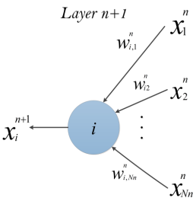



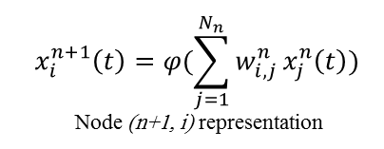
MULTI-LAYER PERCEPTRON MODEL: MATRIX REPRESENTATION
$$x_{i}^{n+1}\left(t\right)=φ(\sum_{j=1}^{N_{n}}{w_{i, j}^{n}}x_{j}^{n}\left(t\right))$$
Node (n+1, i) representation
$$\left[\begin{matrix}\begin{matrix}W_{11} & W_{12} \\ W_{21} & W_{22}\end{matrix} & ⋯ & \begin{matrix}W_{1{, N}_{1}} \\ W_{2{, N}_{1}}\end{matrix} \\ ⋮ & ⋱ & ⋮ \\ \begin{matrix}W_{m−1,1} & W_{m−1,2} \\ W_{m,1} & W_{m,2}\end{matrix} & ⋯ & \begin{matrix}W_{m−1{, N}_{1}} \\ W_{m{, N}_{1}}\end{matrix}\end{matrix}\right]$$
Non-Linear Sigmoid Activation function
$$φ\left(w\right)=\frac{1}{1+e^{−w}}$$
m: number of neurons in the hidden layer
$N_{1}$: number of inputs

Slide 17
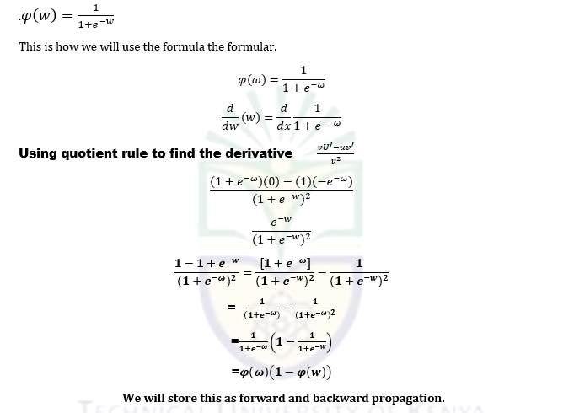
Non-linear

